Slide 1
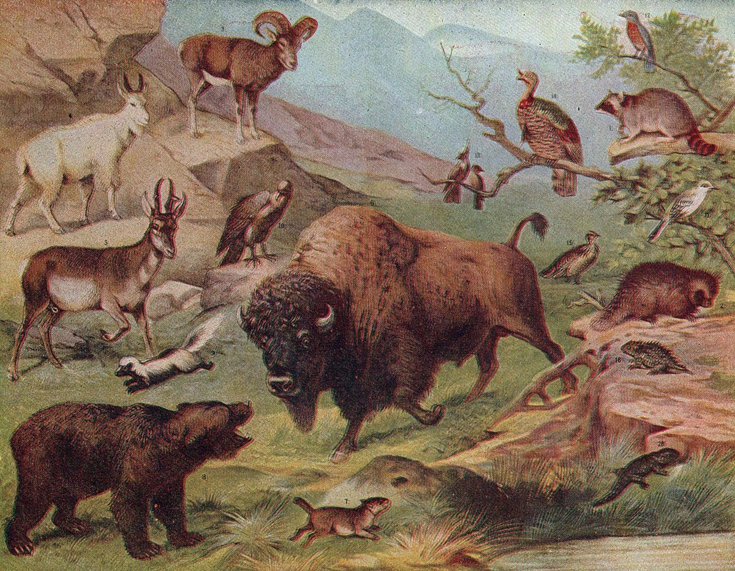

Observed Biodiversity in American National Parks
The data for this project is inspired by real data but is mostly fictional. Data files provided by Codecademy.com

Slide 2

Project Goals
Analyze biodiversity data from the National Parks Service, particularly around various species observed in different national park locations.
This project will answer a few questions:
What is the distribution of conservation status for species ? (slide5)
What is being studied here ? (slide3, plants and animals)
Where were the observations taken ? (gives the abbreviations key for the rest of the slides(wrong, slide4))
What is the most observed animal category ?(6)
How many species are there in each category and each national park ?(2, by park too)
Are certain types of species more likely to be endangered? Which ones ?
What are the differences between species and their conservation status and are they significant ? (the hard one, not tried yet)
DONE --Which animal is most observed and what is its distribution amongst parks ?(6)

Slide 3
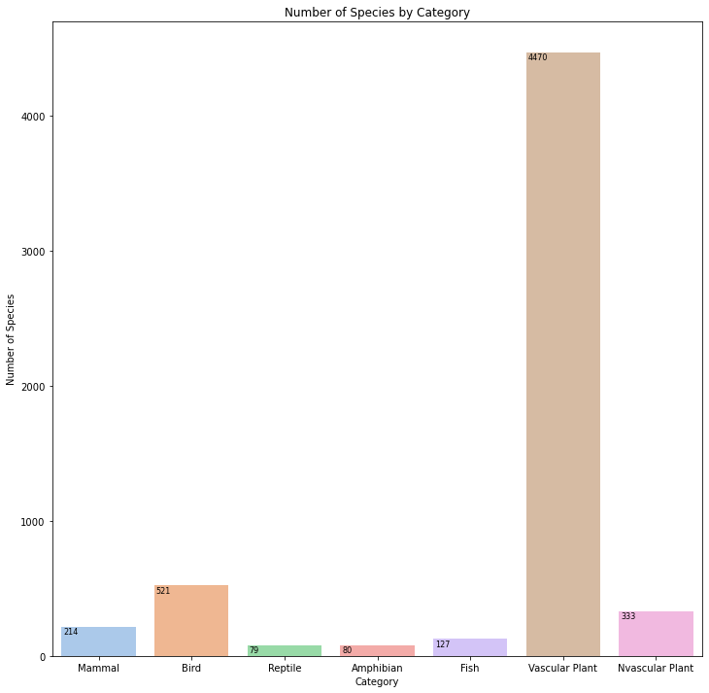
What is being studied
This is a simple chart showing what is being studied in this presentation. As you can tell, the largest variety of species, animal or plant, is the Vascular Plant. Examples include Broad-Leaved Pondweed, Butler's Sandparsley and Wild Parsnip. The Non-Vascular plants are mostly moss.

Slide 4

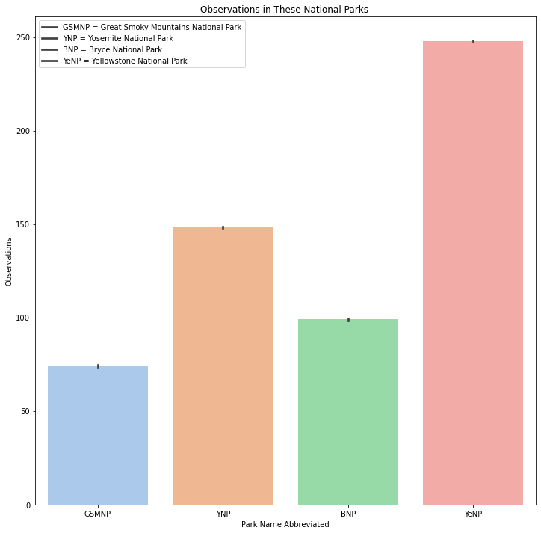
Where the observations were taken
As you can see, Yellowstone National Park is where most of the observations were taken. Yosemite was second.

Slide 5
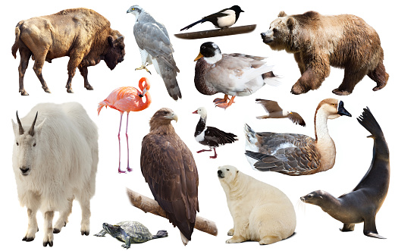
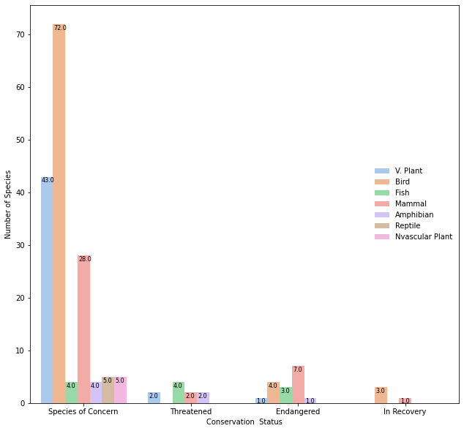
conservation status
A you can see there isn’t a category observed that doesn’t have a species of concern in it. Only two are in recovery and 5 of 7 have endangered species in the category.

Slide 6
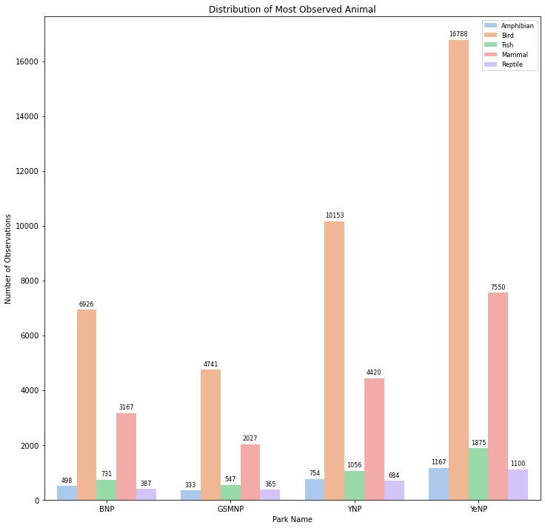
What’s the Most Observed Animal Category ?
As you can see by the graph, the most observed animal category is Birds. Yellowstone has the highest number of observations and Yosemite is second. The next most observed category is mammals, again with Yellowstone having the highest number of observations.

